Slide 1
CAPSTONE PROJECT INITIAL RELEASE
TEAM 14:
JOSE LOPEZ JR| KARNOWSKY ESTIME | ISHWOR GHIMIRE
SOOWON MOON | CAULDIERRE MCKAY

Slide 2
DESIGN CHOICES OVERVIEW
Layered Architecture
Enhanced Security
Authentication
Readability/ Comments

Slide 3
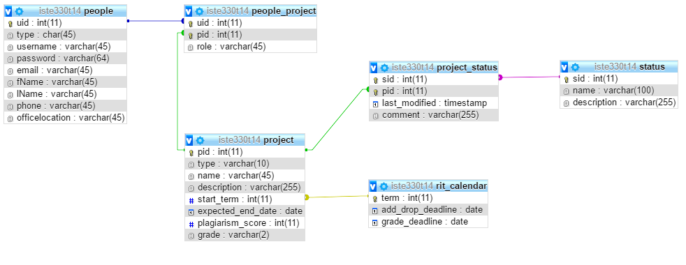
DESIGN CHOICES Database
Our Database is composed of SQL tables and linked together on phpMyAdmin
Database was provided by Floesure and pre-populated

Slide 4
DESIGN CHOICES Data Layer
Consists of Ajax calls that grab data from the database wand allows us to properly display what we want
This data was passed into the PHP functions in Database class.

Slide 5
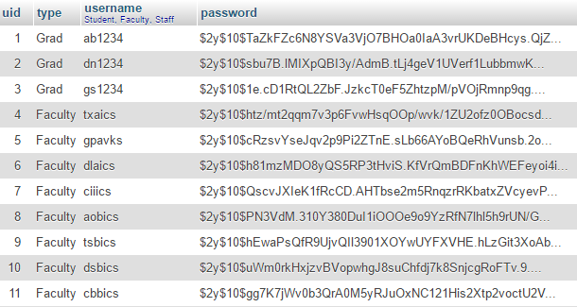
DESIGN CHOICES Business Layer/ Security
Also written in php. We encoded/ hashed the passwords from the beginning so that if there’s a data breach, the passwords aren’t exposed
This was done using online MD5 hash generator to alter the passwords. The php function is able to interpret the hash

Slide 6
DESIGN CHOICES Business Layer/ Security con’t
Use of PDO objects and prepared statements made handling the data more secure. We aren’t prone to sql injections from user input
We also check for authorization. Depending on your login credentials you’re allowed to do certain things. Users who aren’t authorized can’t access the pages that weren’t meant for their eyes

Slide 7

DEMO OF CURRENT STATE
Presentation Layer: mix of php, Jquery, Javascript, and Bootstrap
Grad student capable of viewing/ creating a new capstone
Faculty capable of viewing corresponding projects and accepting capstone proposals
Staff members are capable of viewing/ deleting and changing the status of all projects

